Slide 1

Capstone Project – Sales Analytics

Slide 2
Sales Performance Dashboard
1. Overall Sales Performance
The company generated a total revenue of ₹12,65,793.04, reflecting a strong sales performance across multiple regions, categories, and customer segments.
This figure serves as a benchmark for future growth targets and performance analysis.
2. Total Revenue by Top 5 Countries
USA, Germany, and UK lead revenue generation, contributing the largest share of total sales.
Other countries like France and Brazil also contribute significantly but trail behind the top 3.
3. Total Revenue by Region
Revenue distribution is diversified across regions, with East Coast, Quebec, and Ontario showing particularly strong performance.
A few regions contribute smaller shares, indicating untapped market potential.
4. Total Revenue by Top 10 Cities
London, Berlin, and Madrid emerge as the highest revenue-generating cities, showing strong urban market engagement.
A steady revenue contribution from other cities highlights broad geographic reach, though many smaller cities have untapped potential.

Slide 3
Sales Performance Dashboard
5. Total Revenue by Category
Beverages and Dairy Products lead revenue generation, followed by Confections and Seafood.
These top categories together contribute a major share of overall revenue, indicating strong consumer demand
6. Total Revenue by Country
USA leads in total revenue by a large margin, exceeding 100K.
Followed by Germany, France, and UK, which form the next revenue tier.
Countries like Sweden, Portugal, and Austria have the lowest revenue contributions.
This indicates that the North American and Western European markets are the main revenue drivers.
7. Daily Sales Trend
Sales show consistent fluctuations with periodic spikes throughout the years (1995–1998).
The spikes suggest seasonal peaks, likely linked to holidays or promotions.
There’s no clear upward or downward trend over the entire period, indicating relatively stable demand.
A notable high peak towards the end of the timeline suggests a significant promotional event or seasonal demand surge.

Slide 4
Sales Performance Dashboard
8. Average Sales by Category (Right Chart)
Motorcycles category has the highest average sales, close to 1,000 units.
Followed by Classic Cars and Planes, which still perform well but slightly lower.
Trains and Ships categories show the lowest average sales.
This highlights that Motorcycles drive the highest unit-level demand, potentially worth prioritizing in marketing and inventory planning.
9. Total Revenue by ShipperID (Left Chart)
Shipper 2 contributes the highest revenue (around 0.06M+), outperforming Shippers 1 and 3.
Shipper 3 generates the lowest revenue, indicating possible inefficiencies or lower usage.
This suggests that focusing on Shipper 2’s model or partnership could enhance logistics efficiency and profitability.

Slide 5
Sales Performance Dashboard
9. Average Sales by Supplier (Middle Pie Chart)
Pavlova, Ltd. is the largest contributor (17.4% of total average sales), followed by Exotic Liquid (9.5%).
Several suppliers contribute between 4–6% each (e.g., Helios, Refrescos, Gai Patu Ltd.).
Many small suppliers contribute <2% each, showing a long tail of low-impact vendors.
Insight: High reliance on a few key suppliers (Pavlova, Exotic Liquid). Building strong relationships with them is crucial, but consider diversifying to mitigate risk.
10. Total Revenue by EmployeeID (Right Chart)
Employees 5 and 4 have the highest revenue generation (0.06M each).
Employees 1, 7, and 9 contribute relatively less revenue.
This highlights top-performing employees who could be recognized or analyzed for best practices.
Lower-performing employees may need additional training, resources, or territory review.

Slide 6
Customer Activity
Total Order Customers – 89
A total of 89 unique customers have placed orders with your business.
This gives you a decent active customer base, forming the foundation for further engagement strategies.
Total Orders by All Customers – 830
With 830 total orders placed, the average orders per customer ≈ 9.3 orders per customer, indicating strong purchasing frequency and recurring demand.
Churn Rate – 1.00 (100%)
A churn rate of 100% suggests that none of the customers from the previous period returned in the current period.
Loyal Customers – 5
Only 5 customers meet the criteria of revenue > 50,000 and order count > 10.
These are your high-value clients — representing about 5.6% of total customers — and should be prioritized for loyalty programs, exclusive offers, or premium support.
Total Repeated Customers – 88
Out of 89 total customers, 88 are repeat customers, which is 98.8% repeat rate.
This suggests excellent repeat engagement, which contrasts with the 100% churn rate and further supports that the churn calculation might need validation.

Slide 7
Customer Activity
1. Customer Distribution by Country
The customer base is highly concentrated in a few key countries.
USA, Germany, and UK have the highest number of customers, making them your core markets.
Countries such as Sweden, Portugal, Venezuela, and Brazil have comparatively fewer customers — representing potential growth opportunities for targeted marketing or expansion.
2. Customer Distribution by City
London, Berlin, and Madrid emerge as major city-level hubs, with significantly higher customer counts than other cities.
A long tail of cities shows smaller customer segments, indicating a wide but shallow distribution beyond the top few cities.

Slide 8
Customer Activity
3. Top 10 Customers
A small group of top 10 customers contributes disproportionately to overall revenue.
Customers like Alain Bisse, Jose Poussert, and Roland Mendel lead in total purchases, showcasing high engagement and purchase frequency.
4. Top Performing Products
of sales. Chai, Chang, and Chef Anton's Cajun Seasoning are the top revenue-generating products, with sales far exceeding other products.
The sales distribution shows a classic Pareto pattern (80/20 rule) — a small number of products drive the majority

Slide 9
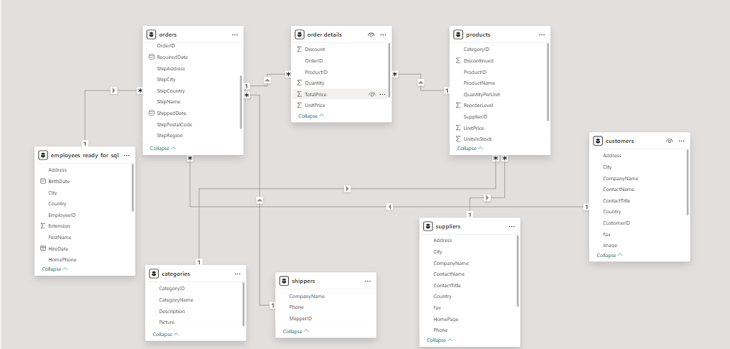
ER Diagram
5

Slide 10

Power BI Sales Performance Dashboard

Slide 11
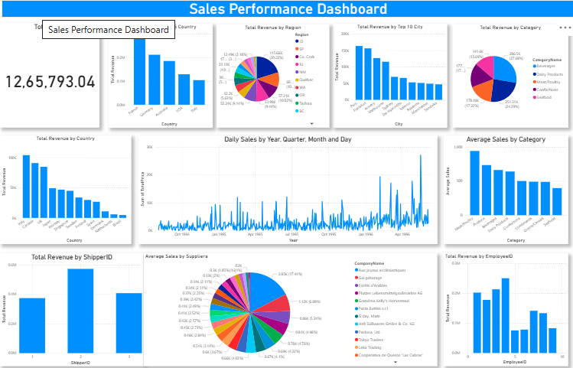
9

Slide 12
Power BI Customer Actvity

Slide 13
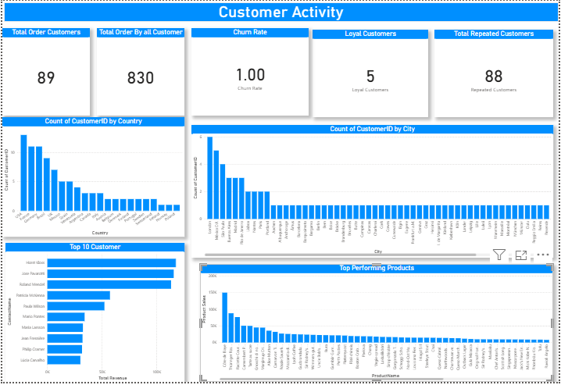
10

